Slide 1

The Advantages of Implementing a Neighborhood-Based Primary Healthcare Model and Clinic
MSC HEALTHCARE LEADERSHIP AND MANAGEMENT
Dr. Pratish
Date of the presentation

Slide 2

Introduction
Topic Introduction and Importance of Primary Healthcare in Neighborhoods:
First point of contact
Promoting community health, preventing illnesses, and addressing minor health concerns
Equitable healthcare distribution
Proactive health management and community engagement
Notes:
Topic Introduction and Importance of Primary Healthcare in Neighborhoods:
Primary healthcare is the first point of contact for individuals seeking medical assistance and preventive care.
It plays a crucial role in promoting community health, preventing illnesses, and addressing minor health concerns before they escalate.
Accessible and well-functioning primary healthcare services are essential in ensuring equitable healthcare distribution within neighborhoods.
Neighborhood-based primary healthcare models aim to bring healthcare services closer to the community, promoting proactive health management and community engagement.

Slide 3

Definition
Characteristics:
Proximity
Community Involvement
Preventive Focus
Interdisciplinary Collaboration
Objectives:
Improve Access to Healthcare
Enhance Community Health Outcomes
Empower Community Participation
Reduce Health Disparities
The neighborhood-based primary healthcare model is a community-oriented approach that aims to deliver comprehensive and accessible healthcare services directly within local neighborhoods.
Notes:
Definition: The neighborhood-based primary healthcare model is a community-oriented approach that aims to deliver comprehensive and accessible healthcare services directly within local neighborhoods.
Characteristics:
Proximity: Healthcare facilities are strategically located within or near neighborhoods, making healthcare services easily accessible to residents.
Community Involvement: The model actively involves the local community in healthcare planning, decision-making, and service delivery, ensuring services cater to specific community needs.
Preventive Focus: Emphasis is placed on preventive care, health education, and early intervention to promote wellness and reduce the burden of preventable illnesses.
Interdisciplinary Collaboration: The model fosters collaboration among various healthcare professionals, social workers, and community organizations to address both medical and social determinants of health.
Objectives:
Improve Access to Healthcare: By bringing healthcare services closer to residents, the model aims to reduce barriers to access, such as transportation issues and geographic distance.
Enhance Community Health Outcomes: The focus on preventive care and community engagement helps improve overall health outcomes, leading to healthier and more resilient communities.
Empower Community Participation: The model seeks to empower community members to actively participate in their health and well-being, fostering a sense of ownership and responsibility.
Reduce Health Disparities: Through targeted interventions and community-specific healthcare initiatives, the model aims to reduce health disparities and ensure equitable healthcare access for all residents.

Slide 4

Aim of the Literature Review: Research Objective
The Advantages for community of Implementing a Neighborhood-Based Primary Healthcare Model
Analyse the impact of such a model on community health outcomes and patient satisfaction.
Proof of potential challenges being overcome by case study
Notes:
The Advantages for community of Implementing a Neighborhood-Based Primary Healthcare Model
Analyse the impact of such a model on community health outcomes and patient satisfaction.
Proof of potential challenges being overcome by case study

Slide 5
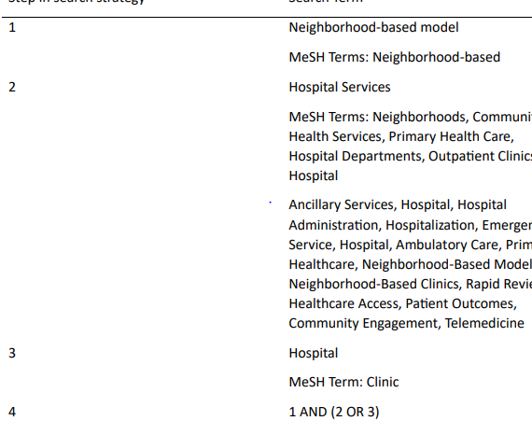
Literature Review Methodology
JBI scoping review guidance followed, and the databases searched (Medline, Web of Science, PubMed, and Google Scholar-Advanced).
15 eligible articles included in this review
Notes:
JBI scoping review guidance followed, and the databases searched (Medline, Web of Science, PubMed, and Google Scholar-Advanced).
The context of included studies was limited to directly a part or influencing the model. This resulted in a total of fifteen eligible articles, which were included in this review

Slide 6
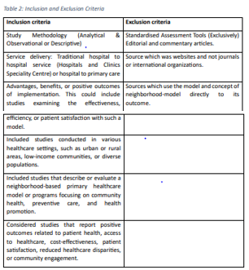
Explain the inclusion and exclusion criteria used to select relevant articles.

Slide 7
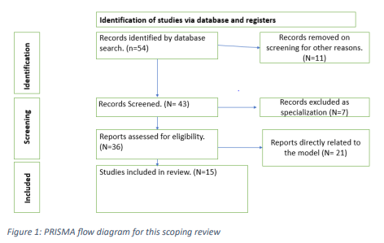

Results
PRISMA Flow showing selection of 15 articles
Identification: 54 articles with the initial search
Screening: 7 articles
Eligibility: Included 36 articles
Included studies: 15 articles
Notes:
PRISMA Flow showing selection of 15 articles
Identification: 54 articles with the initial search (e.g., PubMed, Google Scholar, etc.)
Screening: 7 articles were excluded as specific to medical specializations
Eligibility: Included 36 articles after removing the ones which are not related to examples or the model
Included studies: 15 articles were included from a variety of journals and search articles

Slide 8

Journey through literature review

Slide 9
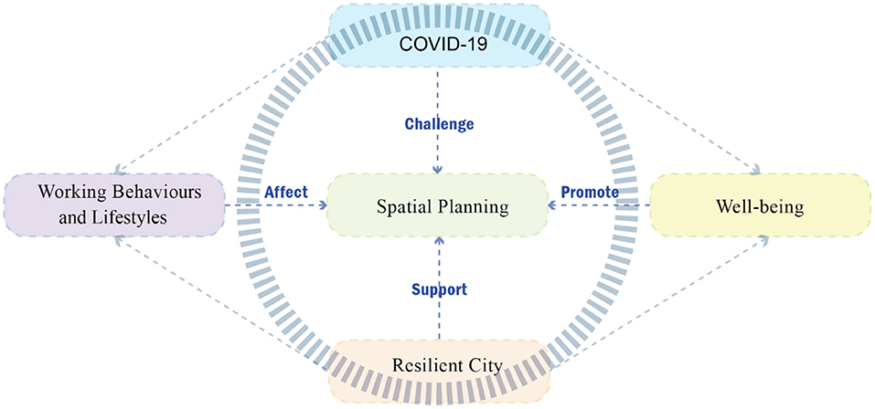
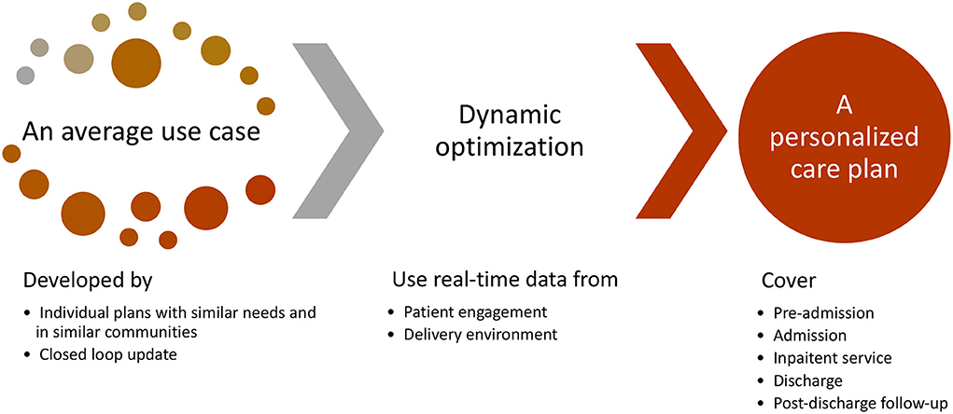
Improved health outcomes arise from early intervention, illness prevention, and prompt treatment facilitated by this approach. [11]
[39]
[42]

Slide 10
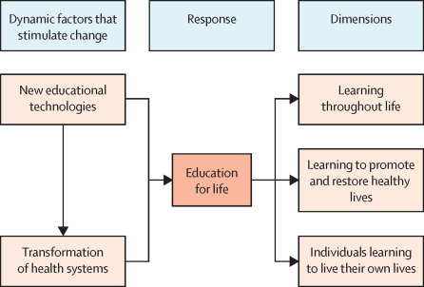
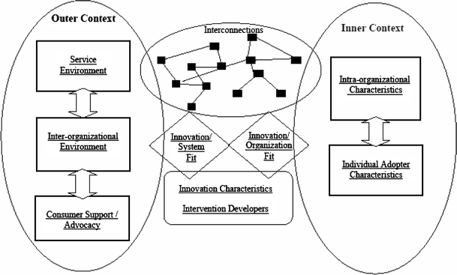
[32]
Social connections are fostered, creating a sense of community and reducing social isolation within these populations. [14]
[38]

Slide 11
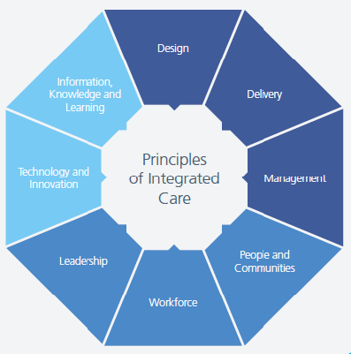
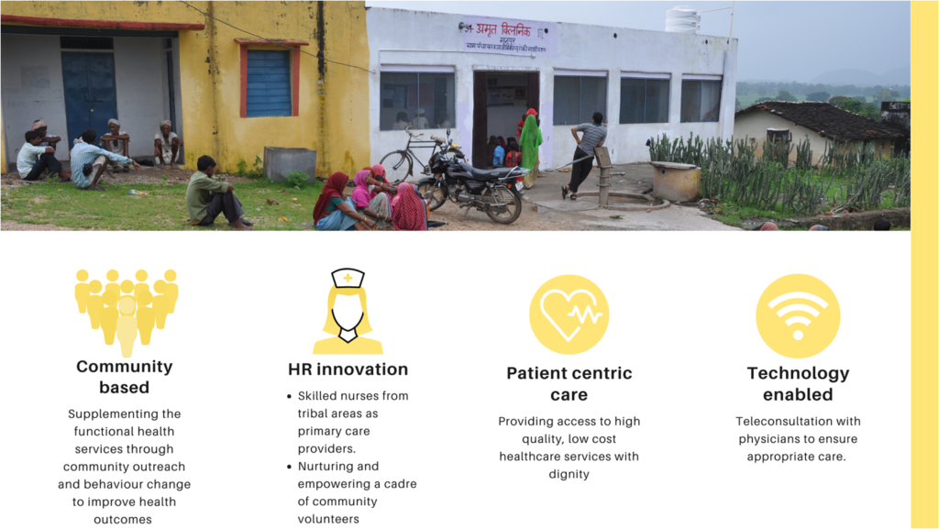
[52]
[44, 45]
The neighborhood-based primary healthcare strategy, including community health centres (CHCs), enhances healthcare access for marginalized communities by ensuring geographical proximity to populations. [1]

Slide 12
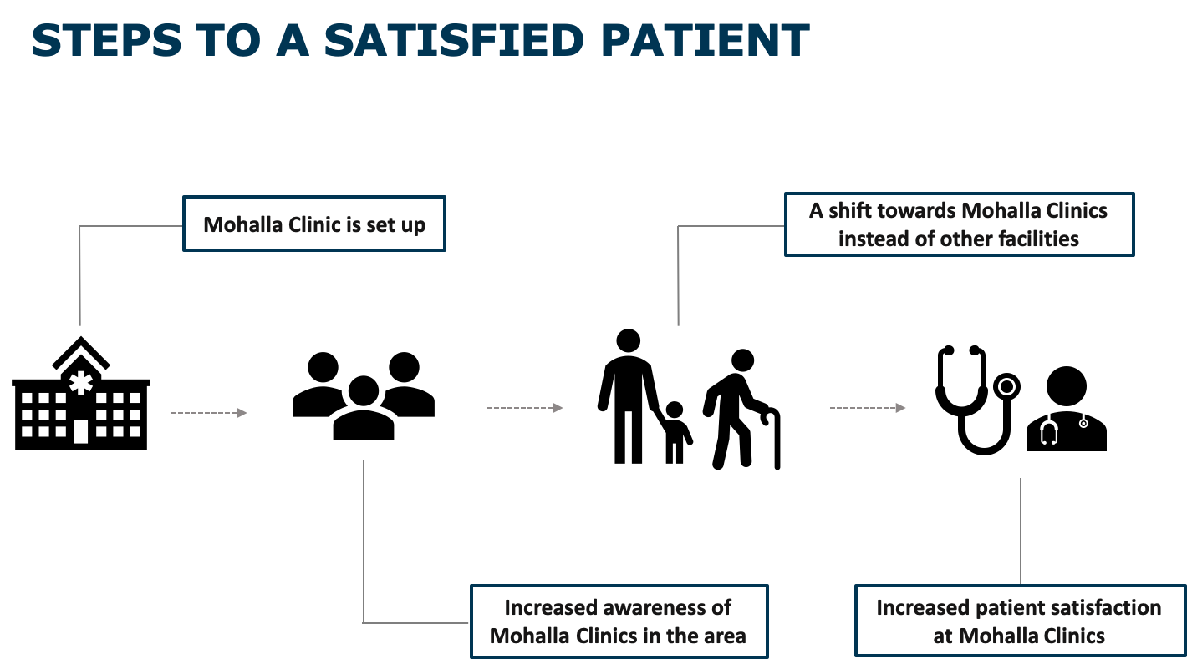
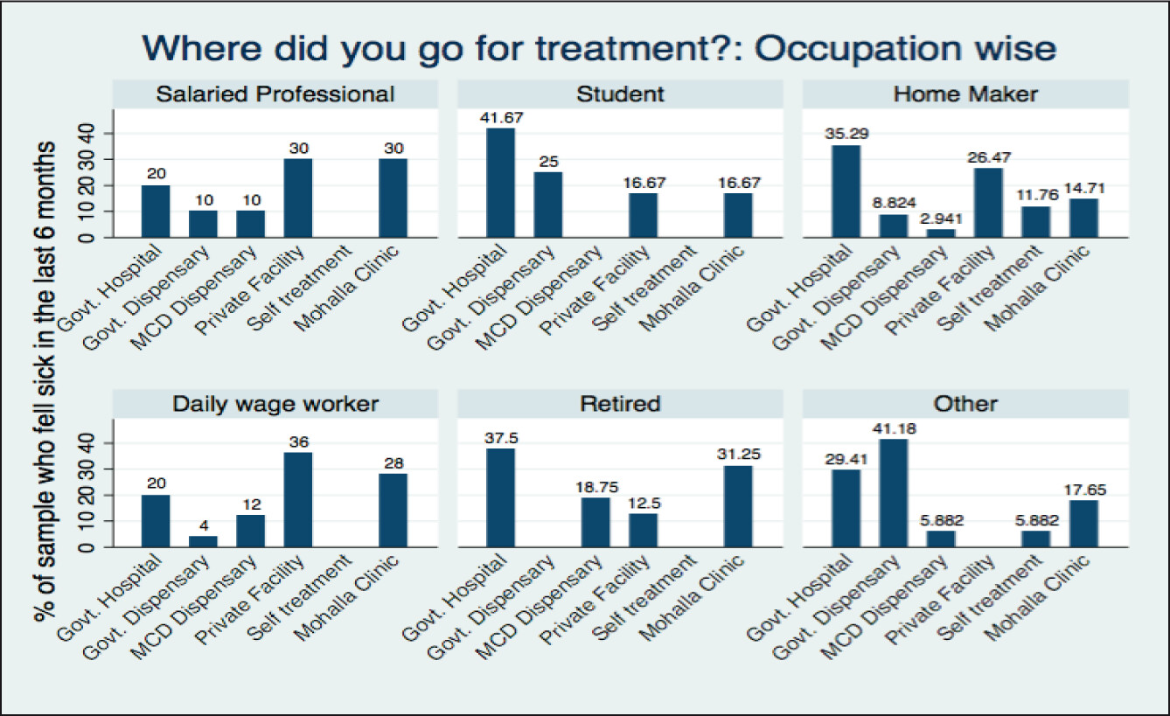
[27, 54]
[29]
The Mohalla Clinic initiative, initiated in 2015, aims to provide accessible and affordable healthcare services to urban underprivileged individuals. [27]

Slide 13

Creating effective and sustainable health systems demands prioritizing comprehensive primary healthcare and public health disciplines and integrating them into national health policies and education to achieve efficient, equitable, and affordable healthcare for all. [52, 54]

Slide 14
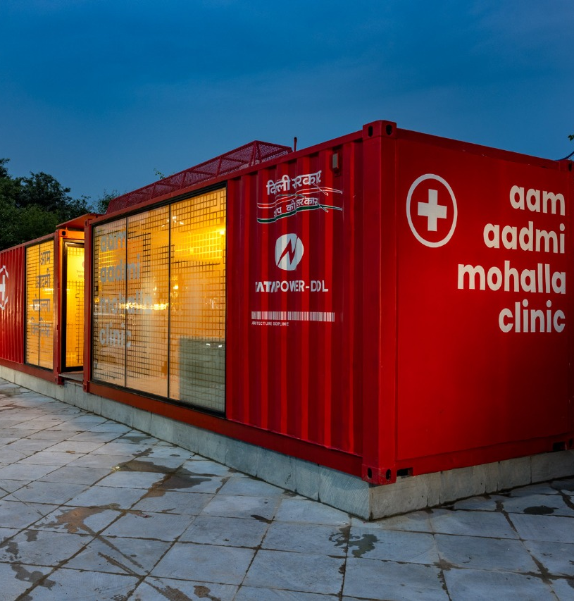
Case Studies
The Mohalla Clinic initiative, started in 2015 for urban underprivileged.
Improved Healthcare Access
Reduced Barriers to Care
Strong Doctor-Patient Bond
Culturally Relevant Care
Affordable Healthcare
Notes:
Mohalla Clinic in Delhi, India: The Mohalla Clinic initiative, started in 2015, provides accessible and affordable healthcare services to the urban underprivileged.
Improved Healthcare Access: Neighborhood-based clinics increase healthcare access for marginalized communities by positioning community health centers (CHCs) geographically to serve nearby populations.
Reduced Barriers to Care: Neighborhood-based clinics decrease access obstacles to care, such as language and transportation difficulties, enhancing overall healthcare accessibility.
Strong Doctor-Patient Bond: Proximity to healthcare services in the neighborhood promotes a solid doctor-patient bond, leading to better communication and understanding of patients' healthcare needs.
Culturally Relevant Care: Neighborhood-based clinics, like the Mohalla Clinic, meet the unique medical requirements and cultural preferences of the communities they serve, ensuring culturally relevant care.
Affordable Healthcare: Community-based clinics, including the Mohalla Clinic, provide more economical care alternatives, making healthcare services more affordable and accessible to underprivileged populations.

Slide 15
Benefits of Neighborhood-Based Primary Healthcare Model through case study
Enhancing Access to healthcare
Improved Community Health
Cost-Effectiveness
Empowerment of Local Communities
Integrated Care
Data-Driven Healthcare
Notes:
Enhancing Access to healthcare: The Mohalla Clinic initiative provides accessible and affordable healthcare services to the urban underprivileged, improving healthcare access and reducing travel time and costs for patients.
Early Diagnosis and Intervention: Neighborhood-based clinics, like the Mohalla Clinic, focus on preventive care and early detection of health issues, enabling timely intervention and reducing the burden of advanced illnesses.
Improved Community Health: The emphasis on preventive measures, health education, and community engagement fosters a healthier population, reducing the prevalence of diseases and improving overall well-being.
Cost-Effectiveness: Neighborhood-based clinics, like the Mohalla Clinic, promote primary healthcare services, reducing the strain on tertiary care facilities and minimizing healthcare costs for patients and the government.
Empowerment of Local Communities: The involvement of community members in the functioning and decision-making of these clinics empowers residents and creates a sense of ownership in their healthcare.
Integrated Care: The Mohalla Clinic model encourages a multidisciplinary approach, bringing together doctors, nurses, pharmacists, and other healthcare professionals to provide comprehensive and coordinated care.
Data-Driven Healthcare: Using technology and data collection, clinics like the Mohalla Clinic can analyze health trends, identify areas of concern, and implement targeted interventions for better health outcomes.

Slide 16

Challenges and Solutions
Proximity
Reduced Waiting Times
Affordable Care
Culturally Relevant Care
Preventive Care and Education
Notes:
Proximity: Neighborhood-based clinics offer healthcare services closer to locals, reducing travel distances and transportation challenges.
Reduced Waiting Times: These clinics see fewer patients compared to larger hospitals, resulting in shorter wait times for consultations and treatments.
Affordable Care: Community-based clinics provide more economical care alternatives compared to larger medical facilities, making healthcare services more accessible to a wider range of people, including those with low incomes.
Culturally Relevant Care: Neighborhood-based clinics meet the unique medical requirements and cultural preferences of the communities they serve, facilitating effective communication between patients and doctors.
Preventive Care and Education: Community-based clinics actively participate in health promotion and preventive care initiatives, leading to better lifestyles and a decline in the prevalence of chronic diseases.

Slide 17
Interdisciplinary Collaboration
Fusion of multiple healthcare service
Teamwork amongst healthcare professionals
Community-based treatment
Patient-centered methods
Reduce healthcare inequities
Policymakers develop equitable and inclusive healthcare system
Notes:
Neighborhood-based primary healthcare model promotes the fusion of multiple healthcare services, such as preventive, curative, and promotional care, in a single environment centered on the community.
Successful care delivery requires teamwork amongst healthcare professionals, and a neighborhood-based primary healthcare paradigm encourages interdisciplinary collaboration and communication among healthcare providers.
Community-based treatment fosters a better bond between medical professionals and the local populace, leading to improved trust, participation, and adherence to treatment regimens.
Implementing a community-based primary healthcare paradigm can significantly improve Integrated Care and Collaboration by encouraging service integration, interdisciplinary teamwork, and patient-centered methods.
The neighborhood-based primary healthcare model has the potential to reduce healthcare inequities and enhance population health because of its emphasis on community involvement, integrated care, and teamwork.
Policymakers can work to develop a more equitable and inclusive healthcare system by enhancing its implementation and promoting additional research.

Slide 18
Conclusion
Improve patient happiness, healthcare access, cost-effectiveness, and overall health outcomes
More sustainable healthcare system due to cost-effectiveness and early identification and management of health issues
Enhance patient satisfaction, leading to improved healthcare utilization and better results
Reduced healthcare costs and well-being for communities
Equitable and effective approach
Viable strategy on proactive and accessible healthcare services adapted for local communities
Notes:
Community-based clinics offer numerous benefits that significantly improve patient happiness, healthcare access, cost-effectiveness, and overall health outcomes.
Neighborhood-based clinics contribute to a more sustainable healthcare system due to their cost-effectiveness and early identification and management of health issues.
The patient-centered approach and individualized care offered by these clinics further enhance patient satisfaction, leading to improved healthcare utilization and better results.
Supporting and implementing community-based clinics can result in enhanced population health, reduced healthcare costs, and overall well-being for communities.
The integration of community-based clinics into existing healthcare systems can lead to a more equitable and effective approach, addressing disparities and promoting better health outcomes for all.
The neighborhood-based primary healthcare model has emerged as a viable strategy that places an emphasis on proactive and accessible healthcare services adapted to fit the requirements of local communities.

Slide 19
Reference
[1] - Star, J., Han, X., Makaroff, L. A., Minihan, A. K., Jemal, A., & Bandi, P. (2023). The first year of the COVID-19 pandemic: Changes in preventive services in community health centers. American Journal of Preventive Medicine, 64(2), 184–193. https://doi.org/10.1016/j.amepre.2022.08.023
[11] - Carlson, L. C., Kim, J., Samuels-Kalow, M. E., Yun, B. J., Terry, D. F., Weilburg, J. B., & Lee, J. (2020). Comparing neighborhood-based indices of socioeconomic risk factors and potentially preventable emergency department utilization. American Journal of Emergency Medicine. https://doi.org/10.1016/j.ajem.2020.03.035
[14] - Merzel, C., & D’afflitti, J. G. (2003). Reconsidering Community-Based Health Promotion: promise, performance, and potential. American Journal of Public Health, 93(4), 557–574. https://doi.org/10.2105/ajph.93.4.557
[27] - Sah, T., Kaushik, R., Bailwal, N., & Tep, N. (2019). Mohalla Clinics in Delhi: A Preliminary Assessment of their Functioning and Coverage. Indian Journal of Human Development, 13(2), 195–210. https://doi.org/10.1177/0973703019872023
[28] - Lahariya, C. (2017). Mohalla Clinics of Delhi, India: Could these become platform to strengthen primary healthcare? Journal of Family Medicine and Primary Care, 6(1), 1. https://doi.org/10.4103/jfmpc.jfmpc_29_17
[29] - Goyanka, R., & Garg, C. C. (2023). Patient perception of attributes of primary care: a study of Aam Aadmi Mohalla Clinics in Delhi, India. Family Practice. https://doi.org/10.1093/fampra/cmac154
[32] - Aarons, G. A., Hurlburt, M. S., & Horwitz, S. M. (2010). Advancing a conceptual model of Evidence-Based practice implementation in public service sectors. Administration and Policy in Mental Health, 38(1), 4–23. https://doi.org/10.1007/s10488-010-0327-7
[38] - Minkler, M. (2005). Community-Based Research Partnerships: Challenges and opportunities. Journal of Urban Health-bulletin of the New York Academy of Medicine, 82(2_suppl_2), ii3–ii12. https://doi.org/10.1093/jurban/jti034
[39] - Bazzoli, G. J., Lee, W., Hsieh, H., & Mobley, L. R. (2011). The effects of safety net hospital closures and conversions on patient travel distance to hospital services. Health Services Research, 47(1pt1), 129–150. https://doi.org/10.1111/j.1475- 6773.2011.01318.x
[42] - Rayner, J. J., Muldoon, L., Bayoumi, I., McMurchy, D., Mulligan, K., & Tharao, W. (2018). Delivering primary health care as envisioned. Journal of Integrated Care, 26(3), 231–241. https://doi.org/10.1108/jica-02-2018-0014
[44] - New care models - what’s the evidence. (n.d.). The Strategy Unit. https://www.strategyunitwm.nhs.uk/publications/new-care-models-whats-evidence
[45] - AMRIT Clinics – Basic HealthCare Services (BHS). (n.d.). https://bhs.org.in/theamrit-solution/
[52] - White, F. (2015). Primary health care and public health: foundations of universal health systems. Medical Principles and Practice, 24(2), 103–116. https://doi.org/10.1159/000370197
[53] - WHO Regional Office for South-East Asia. (2009). Self-care in the context of primary health care. https://apps.who.int/iris/handle/10665/206352
[54] - Lahariya, C. (2020). Access, utilization, perceived quality, and satisfaction with health services at Mohalla (Community) Clinics of Delhi, India. Journal of Family Medicine and Primary Care, 9(12), 5872. https://doi.org/10.4103/jfmpc.jfmpc_1574_20

Slide 20

Questions?

Slide 21
Thankyou!

